Slide 1
Data Mining :
Introduction to Concepts and Techniques
Dr. V. Shyamala Susan,
Head, Asst. Professor,
A.P.C. Mahalaxmi College for Women,
Thoothukudi -628 002.

Slide 2
Module overview
Evolution of Database Technology
Why Data Mining Now ?
What is Data Mining ?
Evolution of Data Mining
Why Data Mining is Important ?
The Scope of Data Mining
Tasks of Data Mining
Major Components of KDD Process
Data Mining : KDD Process
Data Mining – on What Kind of Data ?
Data Mining as Business Intelligence
Data Mining Techniques
Data Mining Technologies
Data Mining Issues
Data Mining Challenges

Slide 3
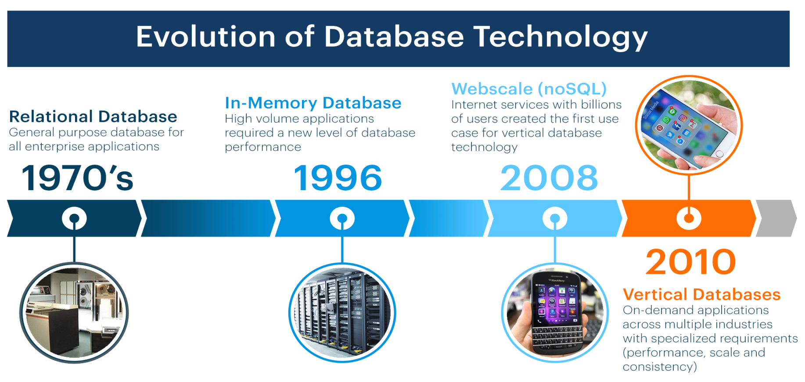


Evolution of Database Technology
Relational database This is a general database suitable for all enterprise applications. | In-Memory Database This database is required for high volume applications. | Web scale (noSQL) Internet services with billions of users created the first use case for vertical database technology | Vertical Databases On-demand applications across multiple industries with specialized requirements

Slide 4
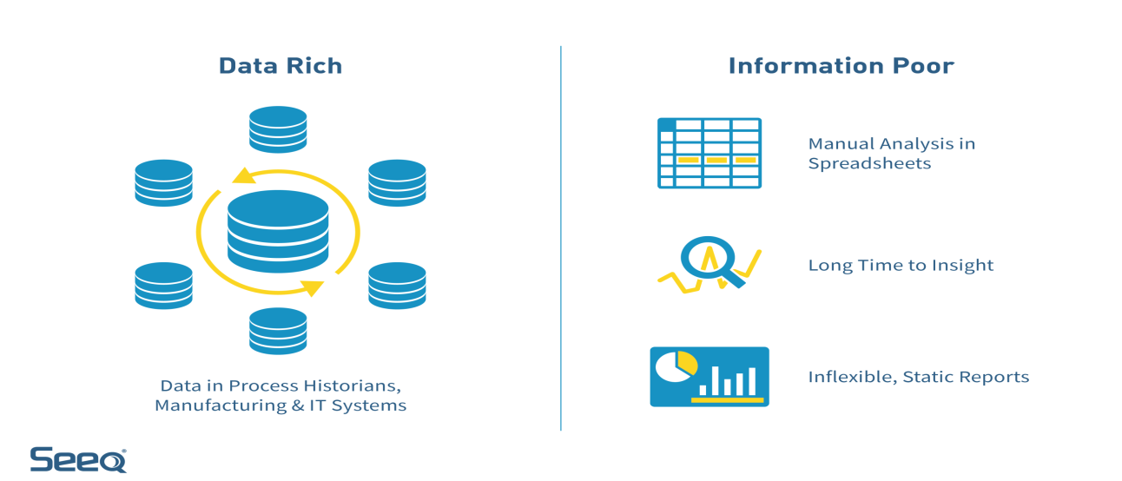
Why Data Mining Now ?
The explosive growth of terabyte-to-petabyte data
Automated data collection tools and database technology
  Business: Web, transactions, e-commerce stocks, …
  Science: Remote sensing, scientific simulation, bioinformatics …
  Society and everyone: YouTube, news, digital cameras,
So we Drown in Data but Starve for Knowledge
Information poor
Data rich
Manual Analysis In Spreadsheets
Long time to insights
In flexible, static reports
Data rich by Business, Science,
Society and IT

Slide 5
What is Data Mining ?
Data Mining : It is the process of identifying anomalies, patterns and similarities within massive data sets. We can increase revenues, split costs, improve customer relationships, minimize risk and more utilising data mining techniques.
Other Names of Data Mining :
Statisticians - Data Fishing, Data Dredging (1960)
AI, Machine Learning Community - Knowledge Discovery in Databases(1989)
Business management term - Business Intelligence(1990)
And also data archaeology, information discovery, information harvesting,, knowledge extraction, data/pattern analysis, etc.

Slide 6
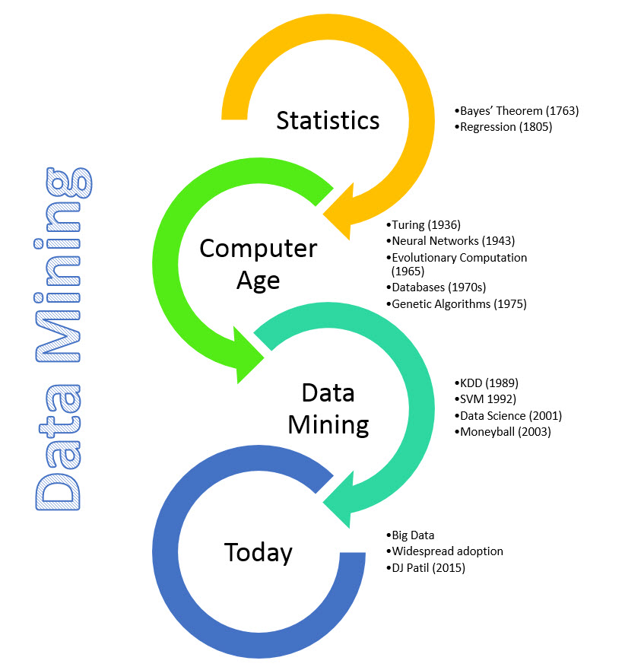
Evolution of Data Mining
Data Mining draws ideas from Statistics /AI , Pattern Recognition etc.
Traditional techniques may be unsuitable due to
huge, distributed and high dimensionality data
Bayer’s Theorem (1763)
Regression (1805)
Turing (1936)
Neural Network (1943)
Evolutionary Computation (1965)
Databases (1970s)
Genetic Algorithms (1975)
KDD (1989)
SVM (1992)
Data Science (2001)
Moneyball (2003)
Big Data
Widespread Adoption
DJ patil (2015)

Slide 7

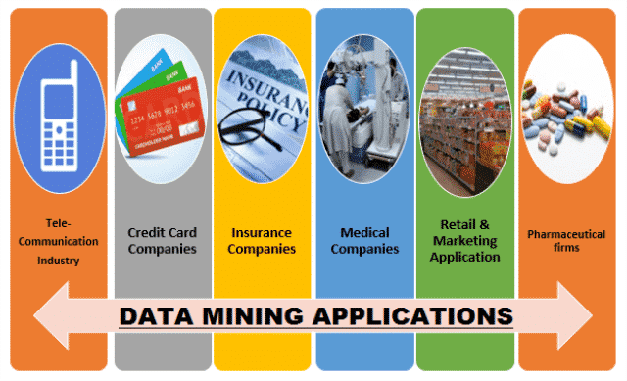
Why Data Mining is Important ?
Data mining helps analysts understand the key facts, relationships, trends, patterns and anomalies that can sometimes go inaccurate
Application of Data mining in different areas:
Tele – Communication Industry
Medical Companies
Retail & Marketing Applications
Pharmaceutical Firms
Credit Card Companies
Insurance Companies

Slide 8
The Scope of Data Mining
Makes it easier to identify important information regarding business in a huge database.
By having certain skills, they generate new market opportunities:
  Automated prediction of trends and behaviors – The information is projected automatically in large databases.
  Questions that historically involved extensive analysis can now be addressed directly from the data easily.
  Predictive major problems include predicting bankruptcy and other forms of default, and classifying segments of a population likely to return equally to events
Automated discovery of previously unknown patterns - Data mining instruments identify previously hidden patterns in one step
Data analyzes on retail sales are designed to identify seemingly unrelated products that are often purchased together.
It also idealizes fraudulent transactions with credit cards and classifies anomalous data that may represent errors in keying data entry.

Slide 9
Tasks of Data Mining
Data mining deals with the types of patterns that may be exploited.
Data Mining tasks
Descriptive
(Ccharacterize the general properties of the data in the database)
Association
(discovers relationships between attributes)
Clustering
(Group similar items together into some clusters)
Predictive
(Perform inference on the current data in order to make predictions)
Summarization
(Maps data into subsets with associated simple descriptions)
Classification
(Assign data into predefined classes)
Prediction
(Predict a real value for a given data instance )
Regression
(Maps data item to a real valued prediction variable)

Slide 10
Major Components of KDD Process
Data mining systems' significant components are a data source, data mining engine, data warehouse server, the pattern evaluation module, graphical user interface, and knowledge base.
The Graphical User Interface (GUI) module needs to communicate between the data mining system and the user.
Graphical User Interface
Pattern evaluation module is responsible for searching patterns
Pattern Evaluation
Data mining engine contains several modules for the operation
of data mining tasks such as classification of associations, clustering, prediction, analysis of time series, etc
Data Mining Engine
Knowledge Base
The database or data warehouse server is composed of the original data ready for processing.
Database Or Data Warehouse Server
Data Cleaning & Data Integration
Filtering
Knowledge base is useful for sharing knowledge and managing user interface
Databases
Data
Warehouses

Slide 11
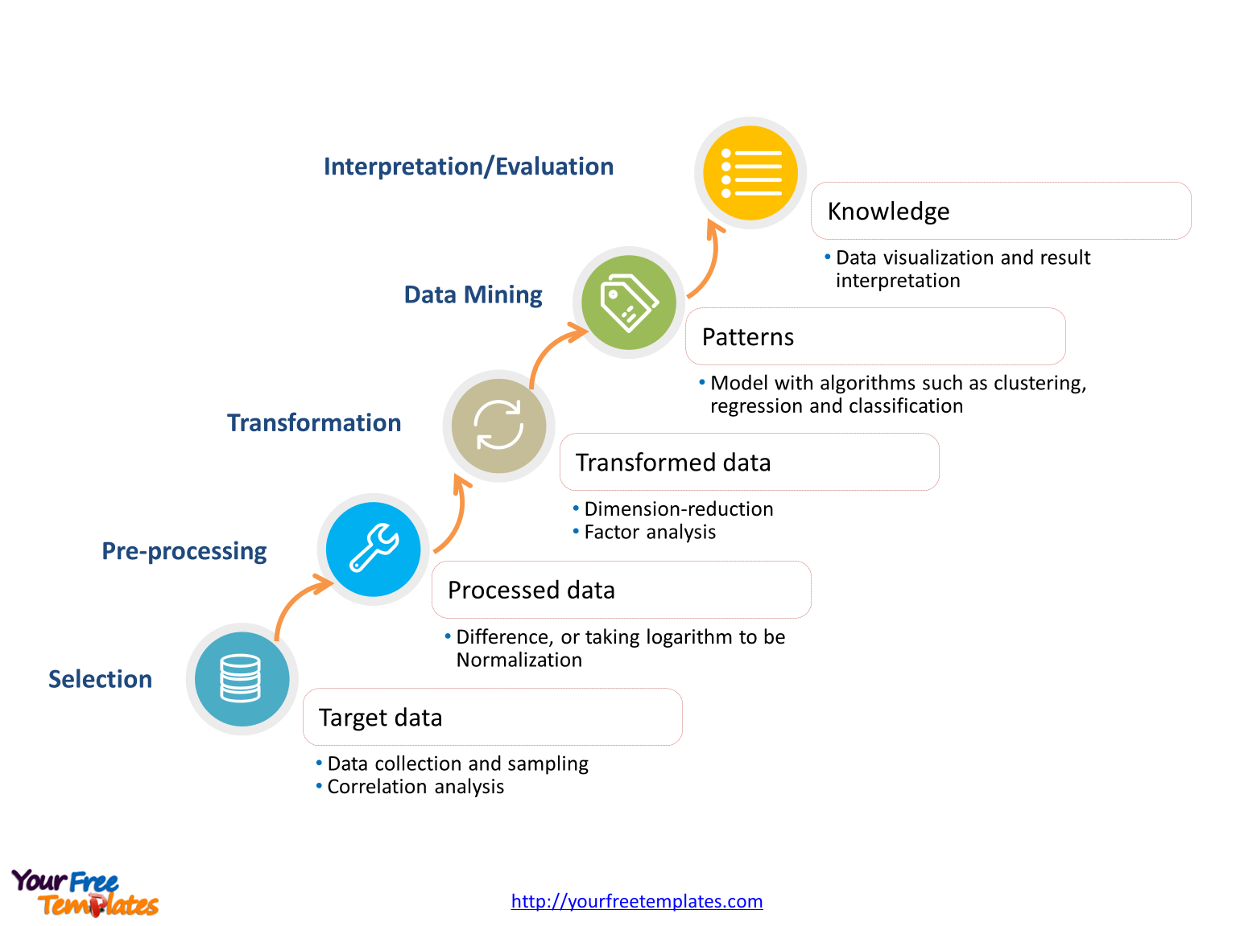
Data Mining : KDD Process
Steps in Data Mining or Knowledge Discovery in Databases ( KDD)
Interpretation / Evaluation
Knowledge
Data visualization and result interpretation
Data mining
Patterns
Model with algorithms such as clustering, regression and classification
Transformation
Transformed data
Dimension reduction. Factor analysis
Pre - Processing
Processed data
Selection
Difference, or taking logarithm to be normalization
Target data
Data collection and sampling. Correlation analysis

Slide 12
Data Mining : KDD Process
Data cleaning and preprocessing: (may take 60 percent of the effort!)
  Removes noise and data
Data integration
  Combines multiple sources of data
Data selection
  Relevant information is collected from the database
Data reduction and transformation:
  The Data is transformed into suitable forms for mining by selecting functions of data mining (summarization, regression, classification, association, clustering for instance
Data mining: Search for patterns of interest
Pattern evaluation and knowledge presentation
  visualization, transformation, removing redundant patterns, etc.
Use of discovered knowledge

Slide 13
Data Mining – on What Kind of Data ?
Data Mining techniques can be applied to any kind of data repositories such as
Relational Databases
Data Warehouse
Transactional Databases
Advanced Systems
Flat Files
World Wide Web.
Advanced database system
object oriented and object relation databases
specific application oriented databases such as spatial database, time series databases, text databases and multimedia databases.

Slide 14
Data Mining – on What Kind of Data ?
Relational Databases - A collection of tables that consists of a set of attributes
Data warehouse - A repository that collects information from multiple sources and stored under a unified scheme residing on a single site.
Transactional Databases- A collection of tables where each record represents a transaction.
Advanced Databases
Object oriented Databases - Databases constructed based on object - oriented programming concept.
Object –Relational Databases - Databases constructed based on an object relational data model.
Spatial Databases – Databases that stores a large amount of space - related data, such as maps, pre-processed remote sensing or medical imaging data and VLSI chip layout data.
Temporal Databases and Time - Series Databases - Databases store both time and relation data. A temporal database usually stores relational data that include time - related attributes and a time series database stores sequence of values or events changing with time.

Slide 15
Data Mining – on What Kind of Data ?
Databases for Text and Multimedia
Text databases store descriptions of words for objects such as long sentences or paragraphs, warnings, summary reports etc.
A Multimedia database system stores a huge collection of multimedia content including data from audio, image , video, sequence, and hypertext.
Heterogeneous Databases and Legacy Databases
A legacy database is a group of heterogeneous databases which combine various types of data systems.
The Internet Site
The world wide web is today a popular and interactive medium for distributing information.

Slide 16
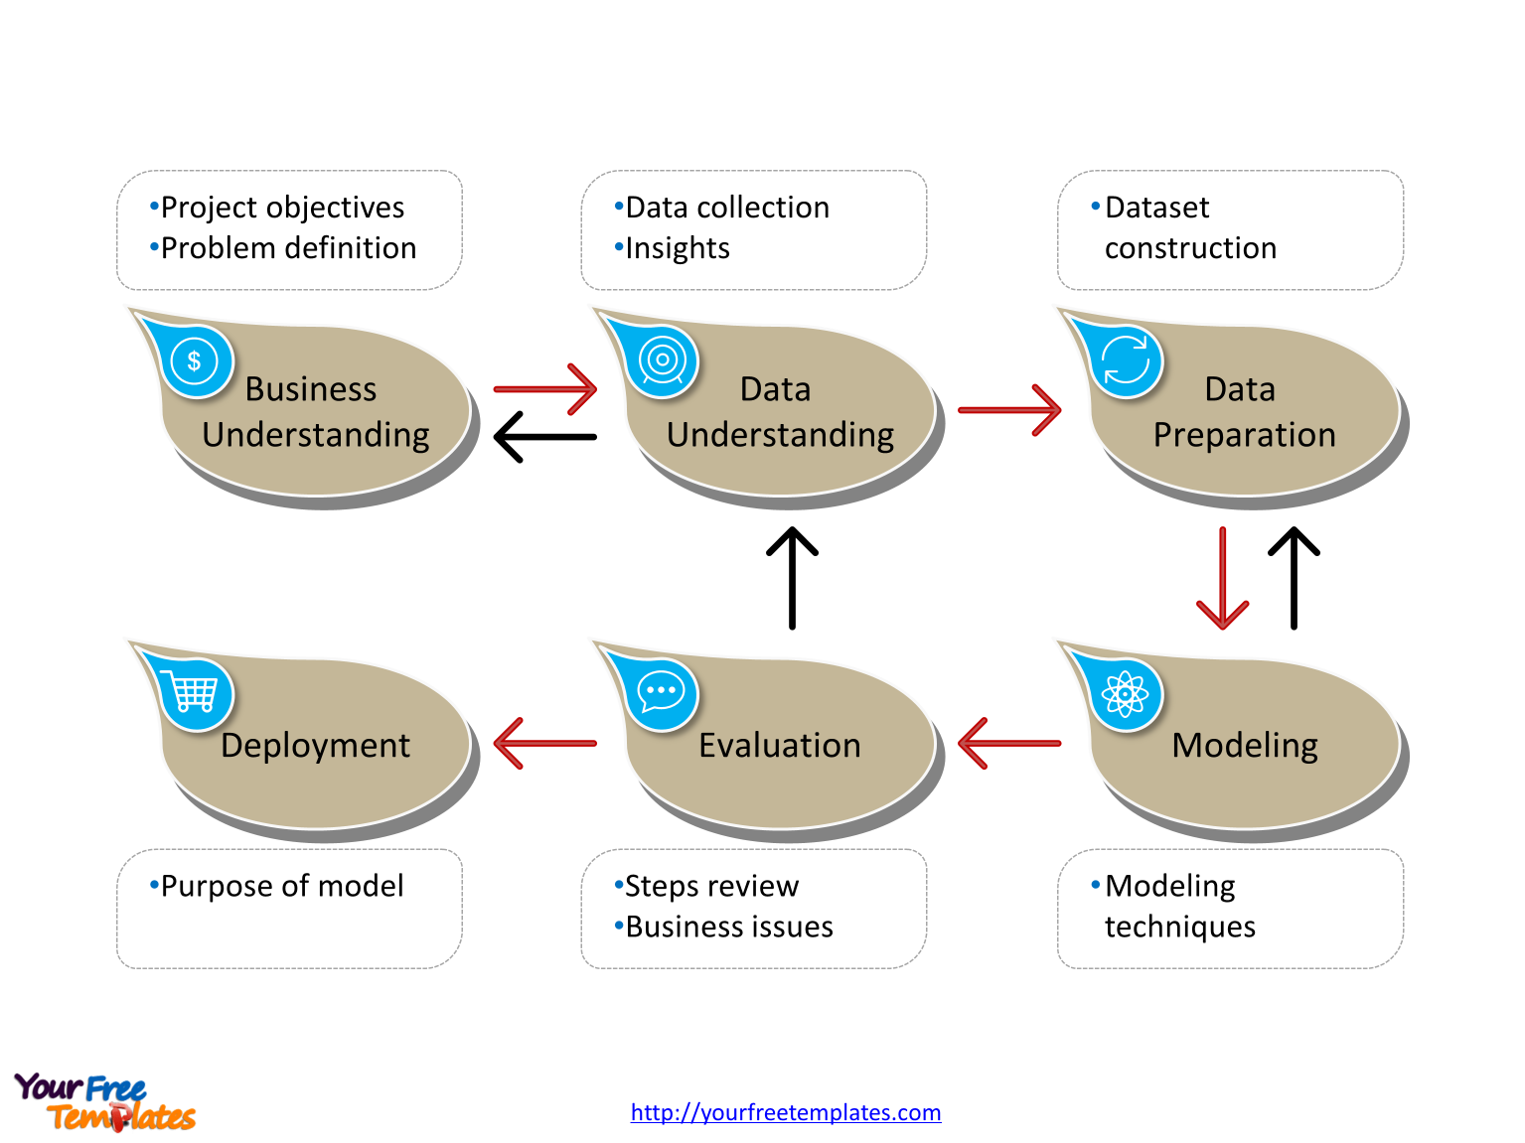
Data Mining as Business Intelligence
Data Mining method identifies important patterns and knowledge from a large amount of information. In these steps, the data patterns are extracted using smart patterns. The data is depicted in the form of patterns and models are organized using clustering and classification techniques
Project objectives
Problem definition
Data collection
Insights
Dataset construction
Purpose of model
Steps review
Business issues
Modeling techniques

Slide 17
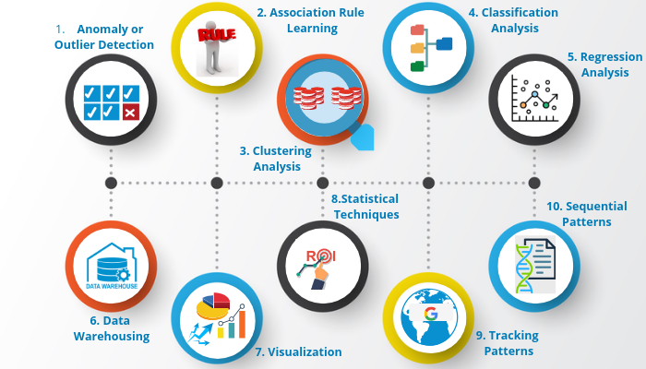
Data Mining Techniques
Data mining methods were introduced and used in huge data sets to find previously unknown, valid relationships and patterns.

Slide 18
Data Mining Techniques
1. Anomaly or Outlier Detection: - It detects the flaws of the data
2. Association Rule Learning: It finds the relations or interesting patterns from the large data set.
3. Clustering Analysis: It identifying similar data from the large data-set and grouping them
4. Classification Analysis: It obtains information about the data.
5. Regression Analysis: It helps to identify the relationship between the different variables.
6. Data Warehousing: It is the technique of storing large quantities of structured data securely
7. Visualization: It is the process of tabulating data in the form of graphs, charts and diagrams and digital images.
8. Statistical Techniques: It calculates the mean, mode, and median of the data to predict future patterns.
9. Tracking Patterns: It identifies patterns from the current database.
10. Sequential Patterns: It identifies the sequence of the data.

Slide 19
Data Mining Technologies
Data mining has integrated numerous techniques from other fields such as statistics, machine learning , pattern recognition, data system and data warehouse systems , information retrieval, visual analytics, algorithms, high-performance computing and many specific applications
Data Mining Technologies
Machine Learning
Pattern recognition
Data warehouse
Information retrieval
Visualization
Statistics

Slide 20
Data Mining Issues
Major issues in data mining are mining methodology, user interaction, performance, and diverse data types.
Mining Methodology and User Interaction Issues
Mining various methods and techniques in databases
Interactive knowledge mining at numerous abstractional levels
Adding background information
Languages used in data mining and ad hoc data mining
Presentation and visualisation of the results of data mining
Handling incomplete or noisy data
Evaluating patterns
Performance Issues
Data mining algorithms are efficient and scalable.
Parallel and distributed mining algorithms, and incremental
Issues Relating to the Diversity of Database Types
Handling of the related and complex data types
Mining heterogeneous databases and global information systems

Slide 21
Data Mining Challenges
Data mining is hindered by the increasing quantity and complexity of big data, security, scalability, data quality and streaming data
Data Mining Challenges
Big Data
Privacy & Security
Cost of Scale
Overfitting

Slide 22
Summary
Evolution of Database Technology
Why Data Mining is important nowadays?
Data Mining discovers interesting patterns from the data
Evolution of Data Mining
The important of data mining in different field
The Scope of Data Mining
The different tasks of Data Mining
The significant components of data mining systems are a data source, data mining engine, data warehouse server, the pattern evaluation module, graphical user interface, and knowledge base.
KDD Process to obtain knowledge from data
What Kind of Data can be mined
Data Mining as a Business Intelligence, process identifies interesting patterns and knowledge from a large amount of data. In these steps, intelligent patterns are applied to extract the data patterns. The data is represented in the form of patterns and models are structured using classification and clustering techniques
Data mining techniques have been developed and used to find previously unknown, valid patterns and relationships in huge data sets.
Data mining has incorporated many techniques from other domains such as statistics, machine learning, pattern recognition, database and data warehouse systems, information retrieval, visualization, algorithms, high performance computing, and many application domains
Major issues in data mining are mining methodology, user interaction, performance, and diverse data types.
Data mining is hindered by the increasing quantity and complexity of big data, security, scalability, data quality and streaming data

Slide 23
Thank You

